Slide 1

Esco Products, Inc
Technical Services: Christopher Haught
Visual Oil Analysis
Tools and Methods for Monitoring and Maintaining the health of equipment and in-service lubricants.
https://stle.webex.com/stle/j.php?MTID=m15c8a350f27e182f042996377889ffae
Notes:
Meeting number (access code): 282 368 897
Meeting password: qtg6sa66
When it's time, join the meeting.
Join by phone
1-877-668-4493 Call-in toll-free number (US/Canada)
1-650-479-3208 Call-in toll number (US/Canada)

Slide 2
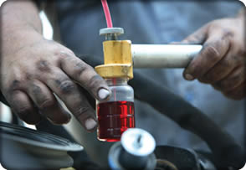
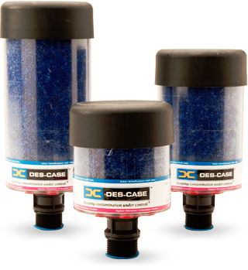
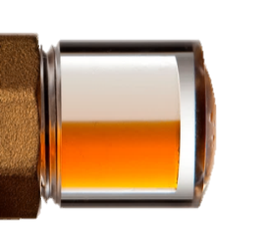
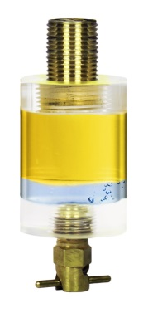
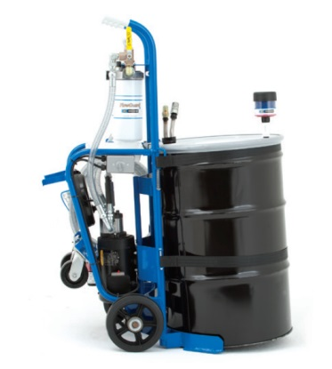

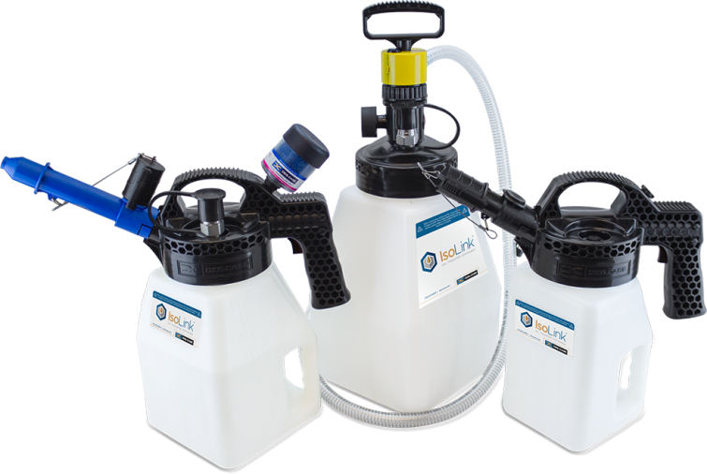
Contaminant Prevention & Removal
Lubricant Selection & Handling
Condition Monitoring & Technical Training

Slide 3
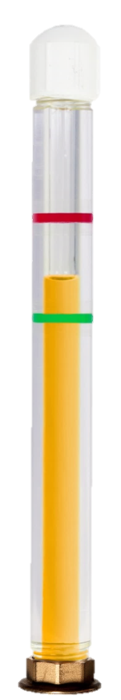


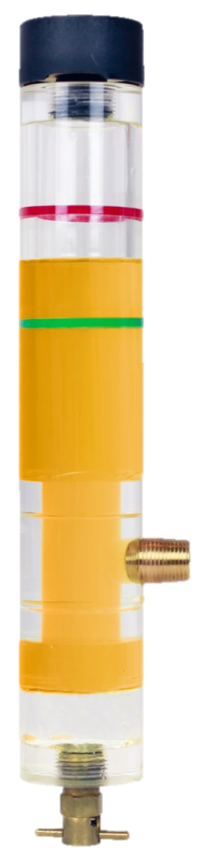

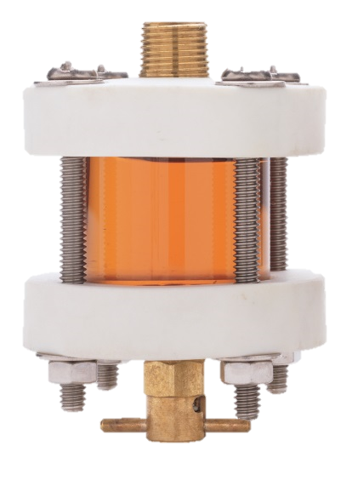
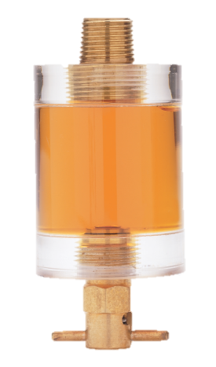
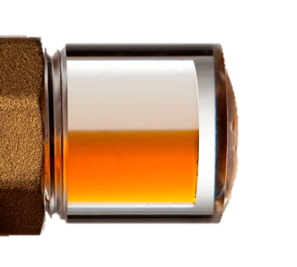
Visual Oil Analysis
Tools to easily monitor the condition of your oil.

Slide 4

Defining Visual Oil Analysis
Gaining a better understanding of the condition of a machine or the health of a lubricant simply through observation.
Correct Level of Oil in Equipment
Presence of Water
Presence of Sediment
Color of Oil
Clarity of Oil
Foaming
Excessive Operating Temperature
Source of Contamination

Slide 5
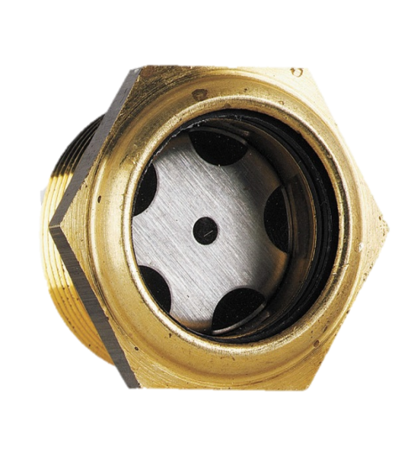

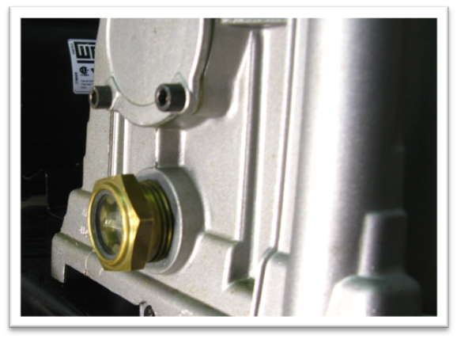
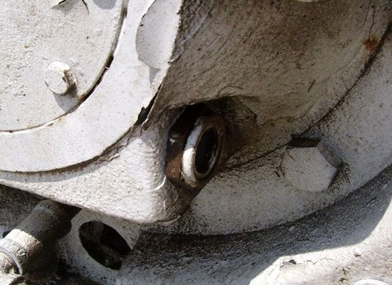
Problems With Existing Sight Glasses

Slide 6
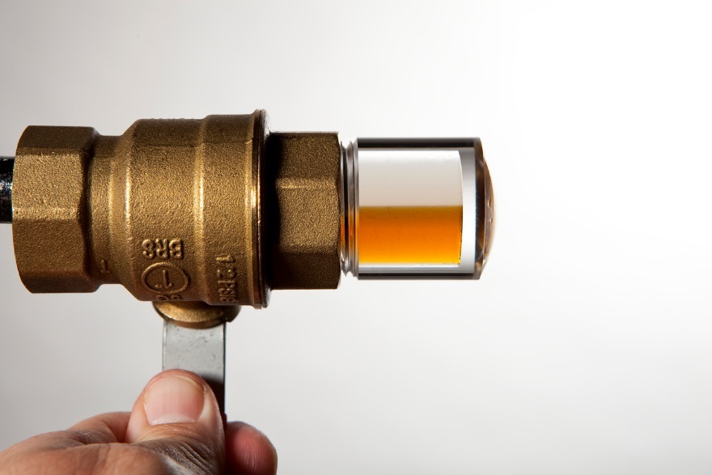
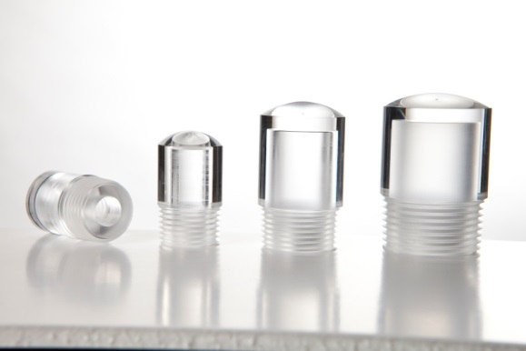
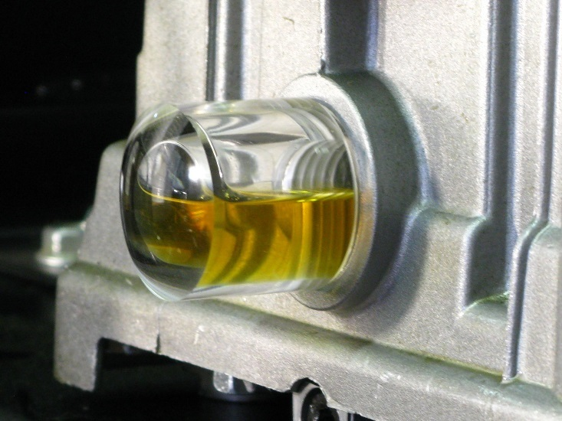
3-D BullsEyes – Easily Monitor Fluid Levels

Slide 7
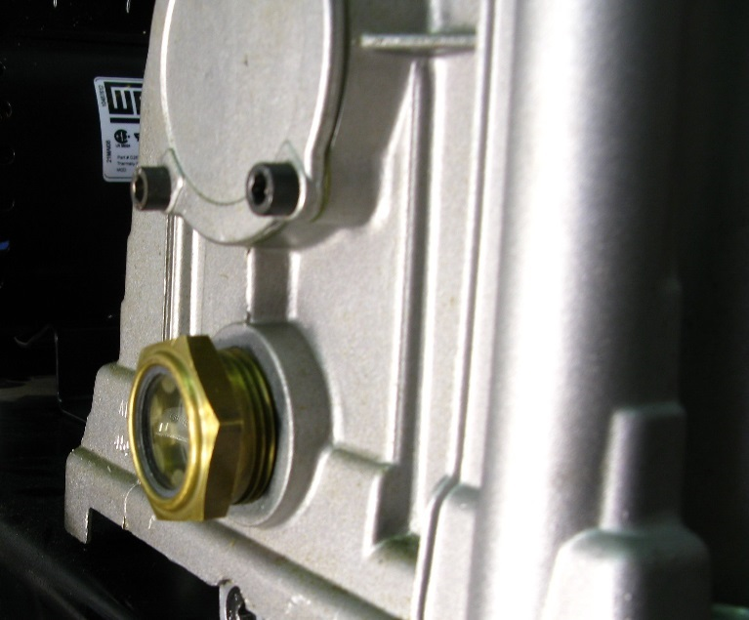
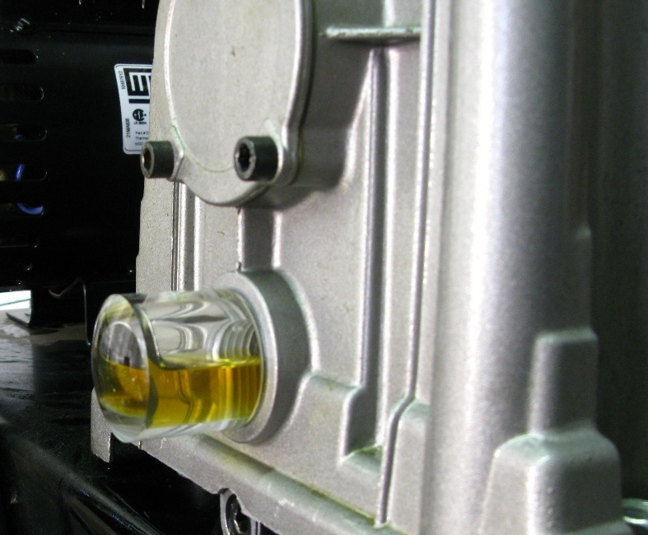
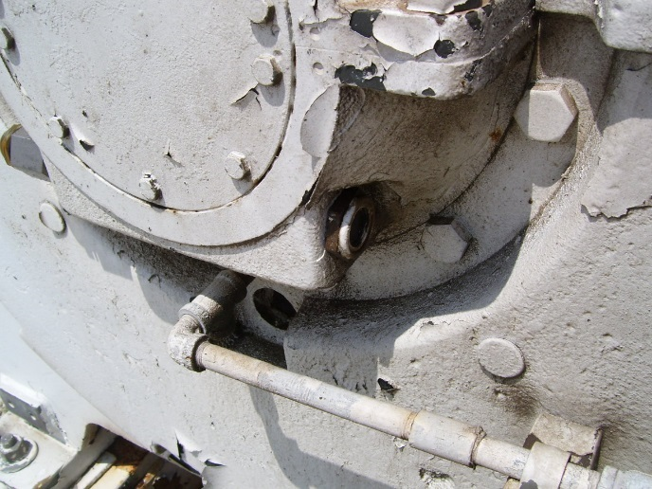
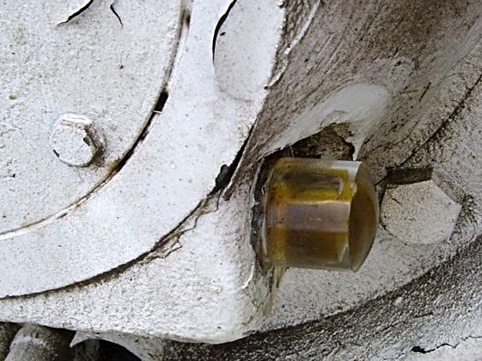
Equipment Upgrades: 3-D BullsEyes

Slide 8
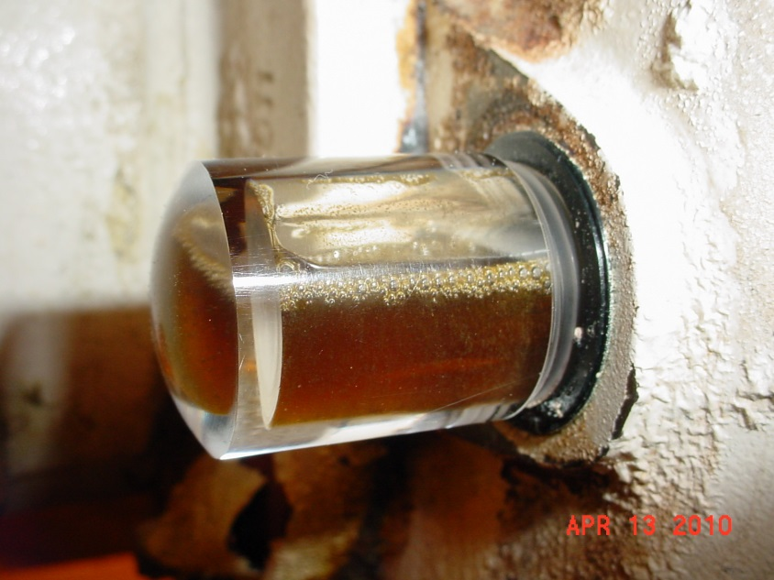

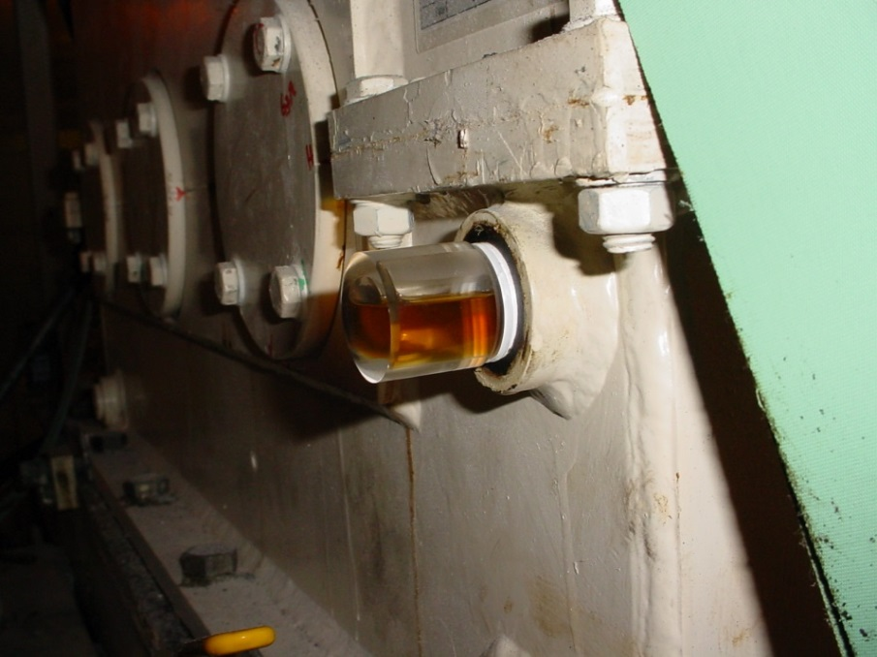
Equipment Upgrades: 3-D BullsEyes

Slide 9
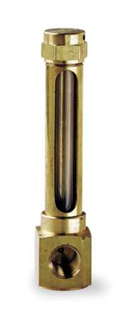
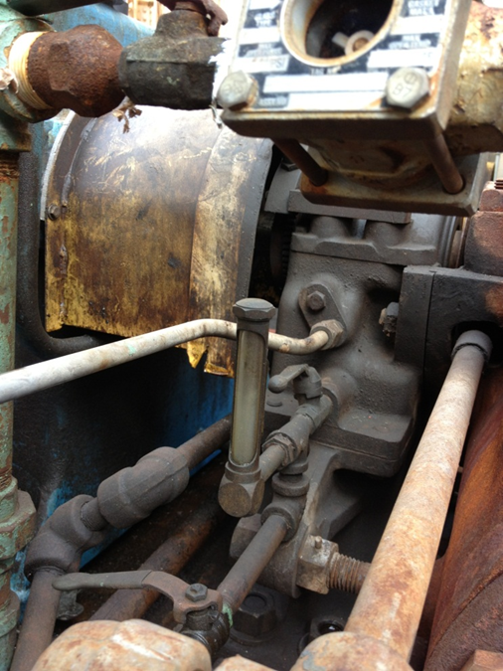
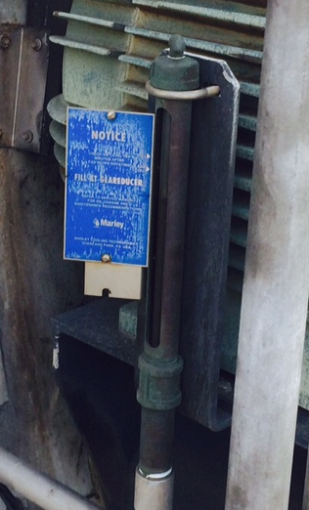
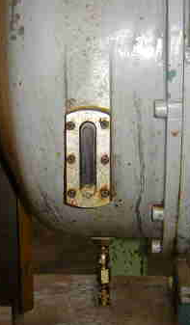
Problems With Current Level Monitors

Slide 10
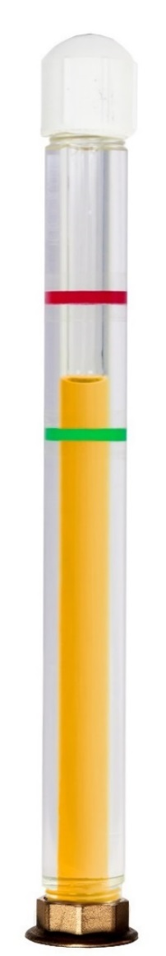
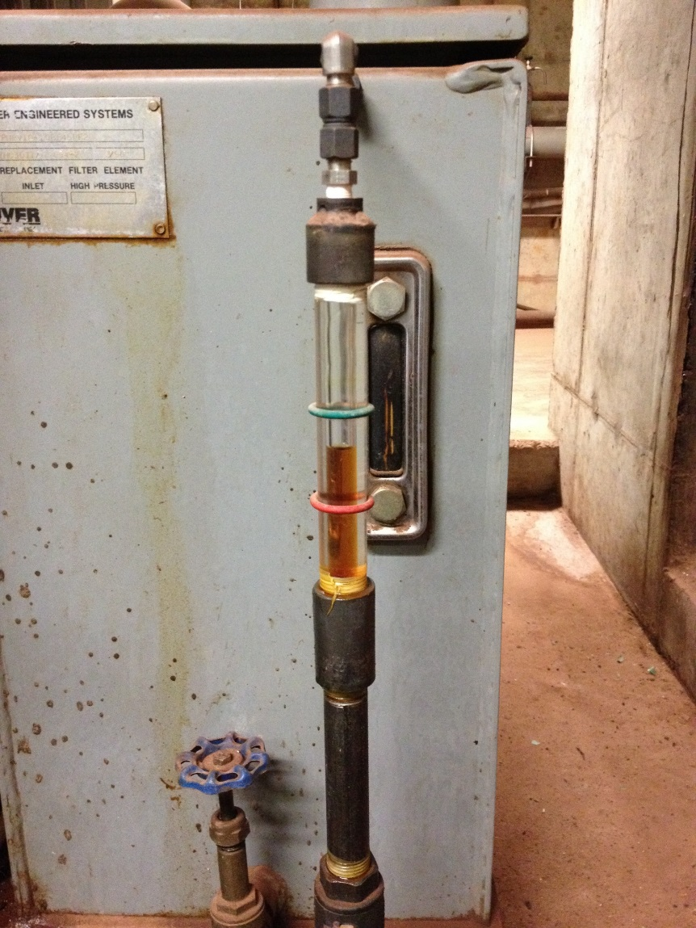
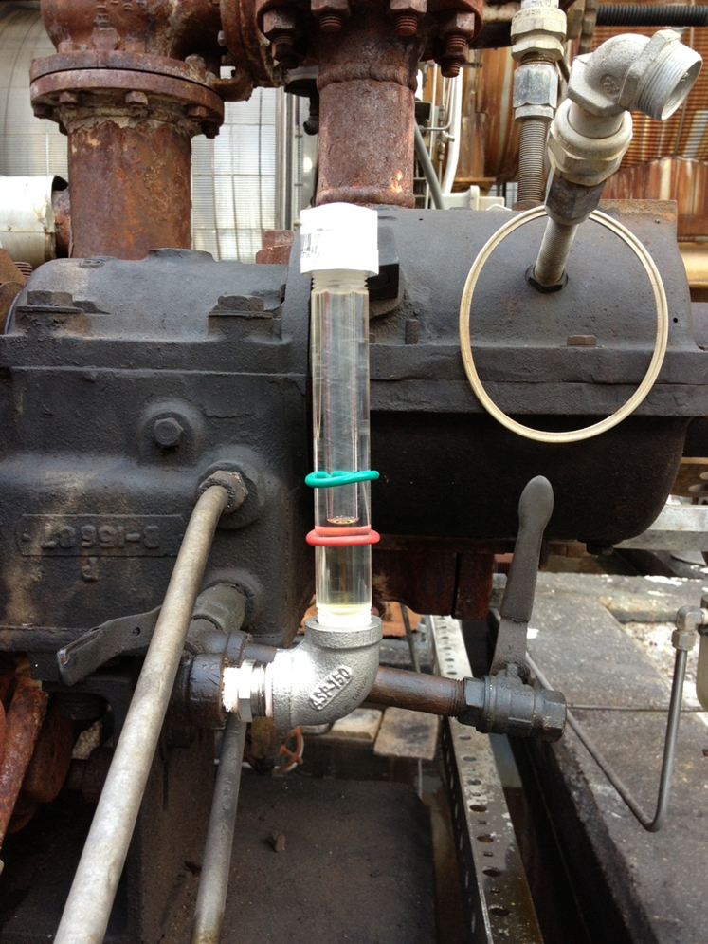
Equipment Upgrades - Oil Level Indicators

Slide 11
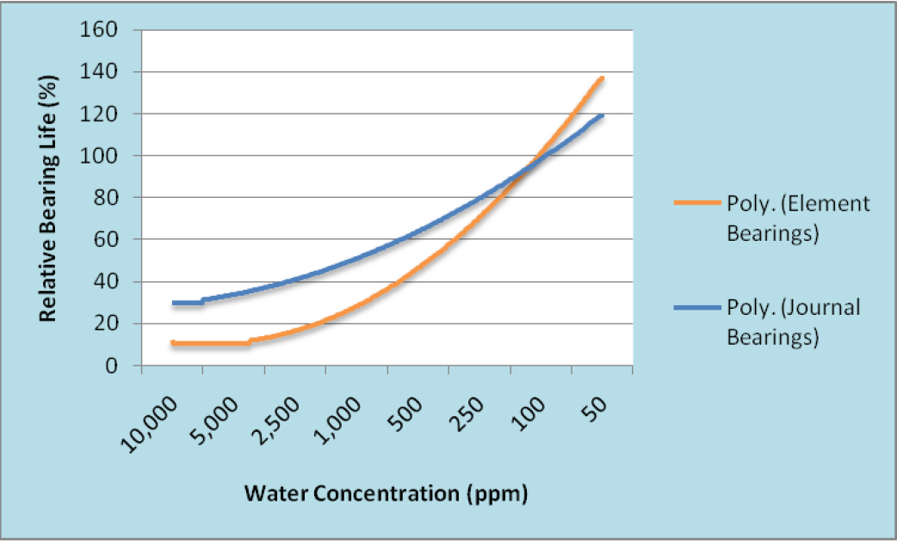
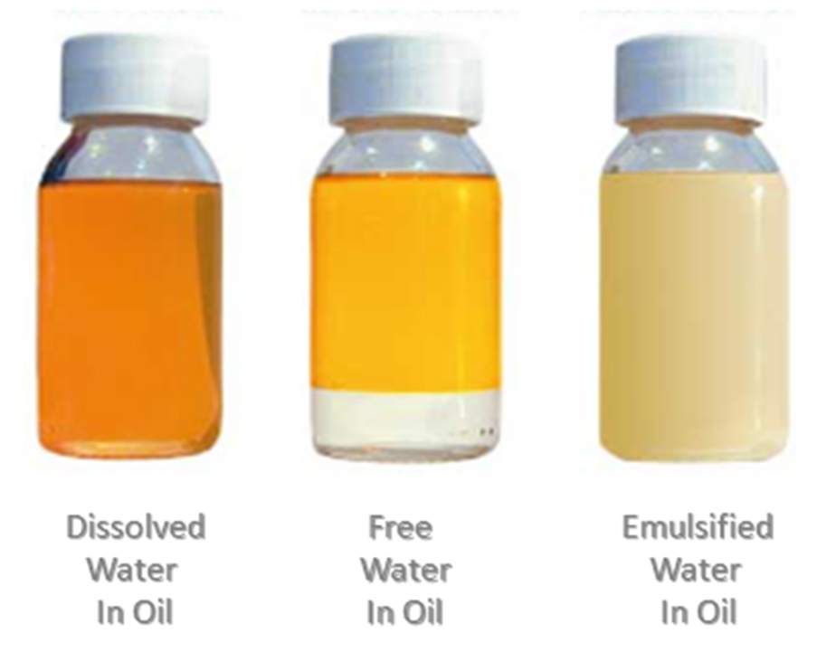
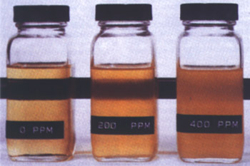
Managing Water Contamination
Clear & Bright

Slide 12
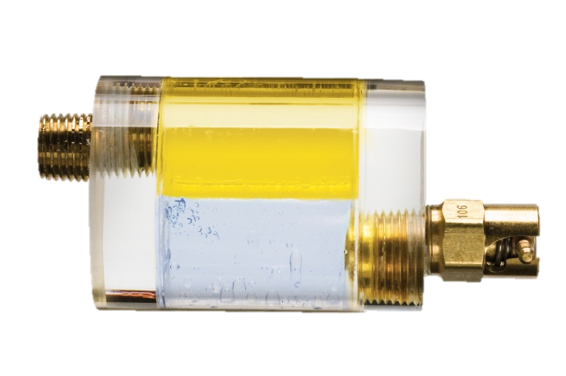
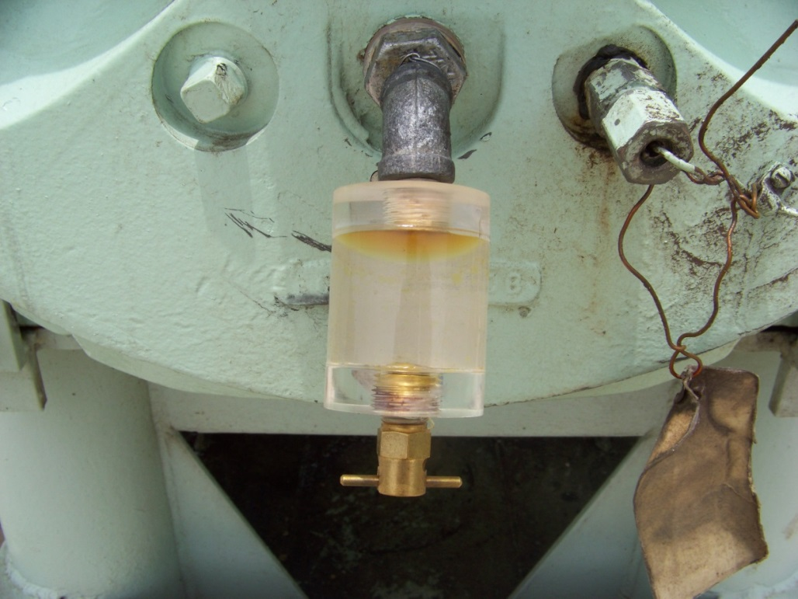
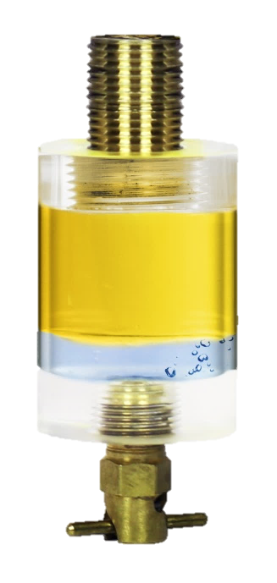
Oil Sight Glasses
Collect and remove free-floating water and debris from your oil.

Slide 13
Oil Sight Glasses
How They Work
Oil Reservoir

Slide 14
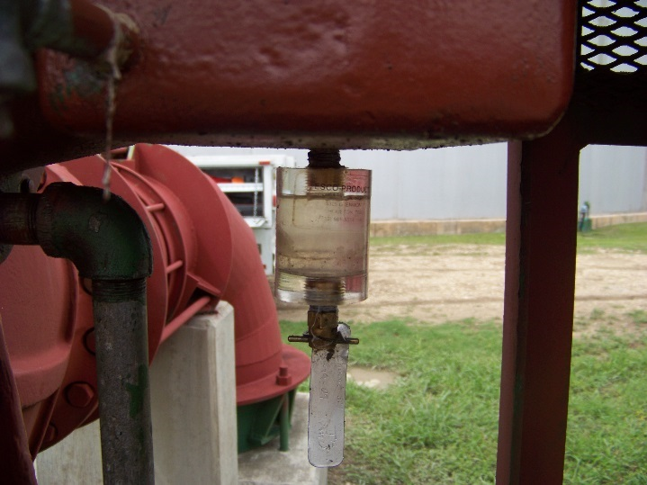
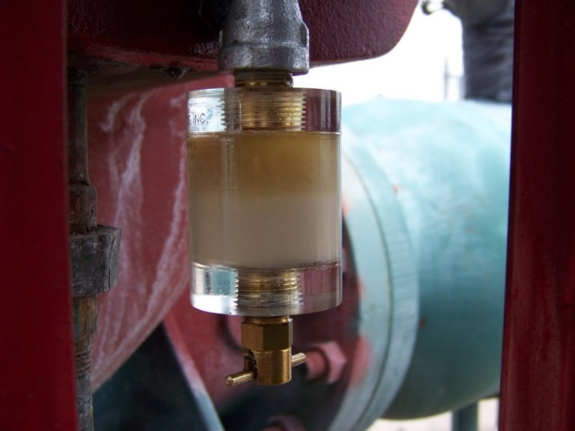
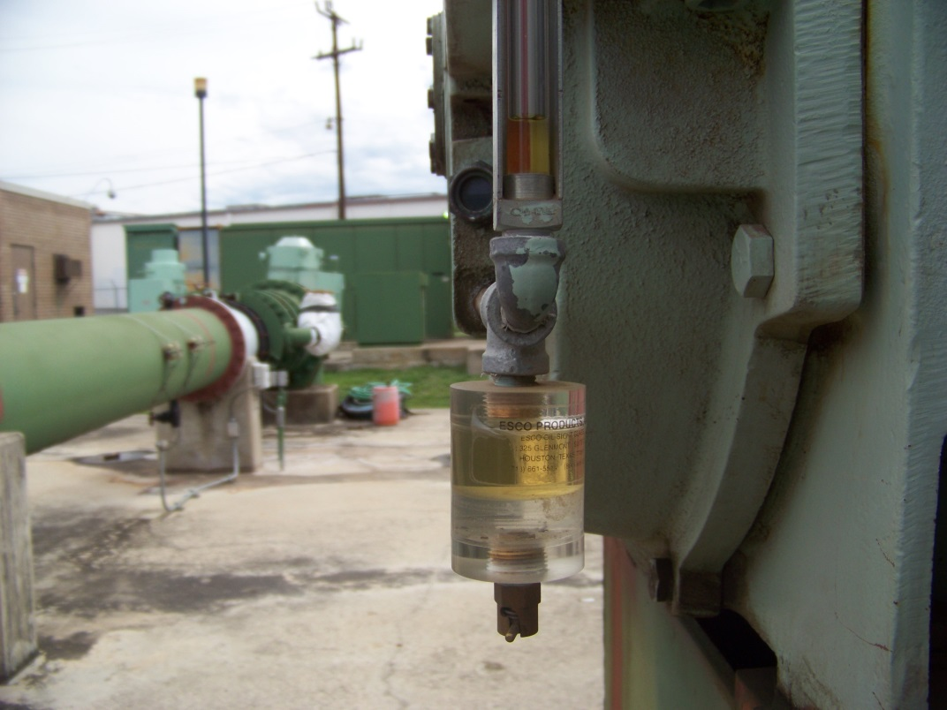

Oil Sight Glasses in Action

Slide 15
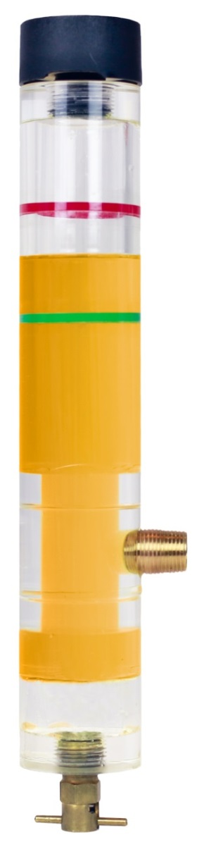
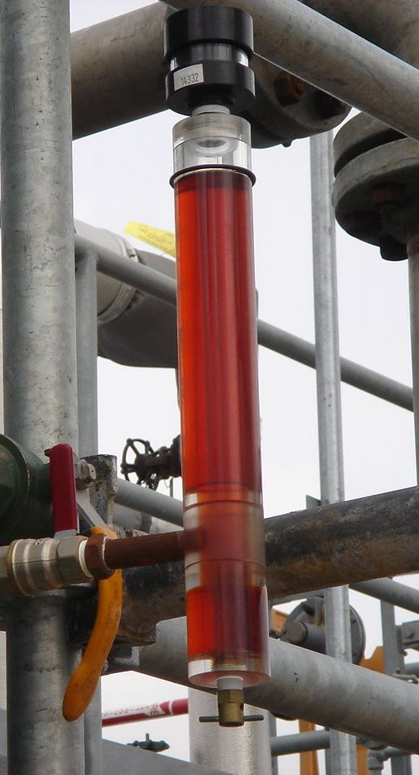
Oil Sight Glass & Level Monitor

Slide 16

Oil Sight Glass & Level Monitors
Oil Reservoir

Slide 17
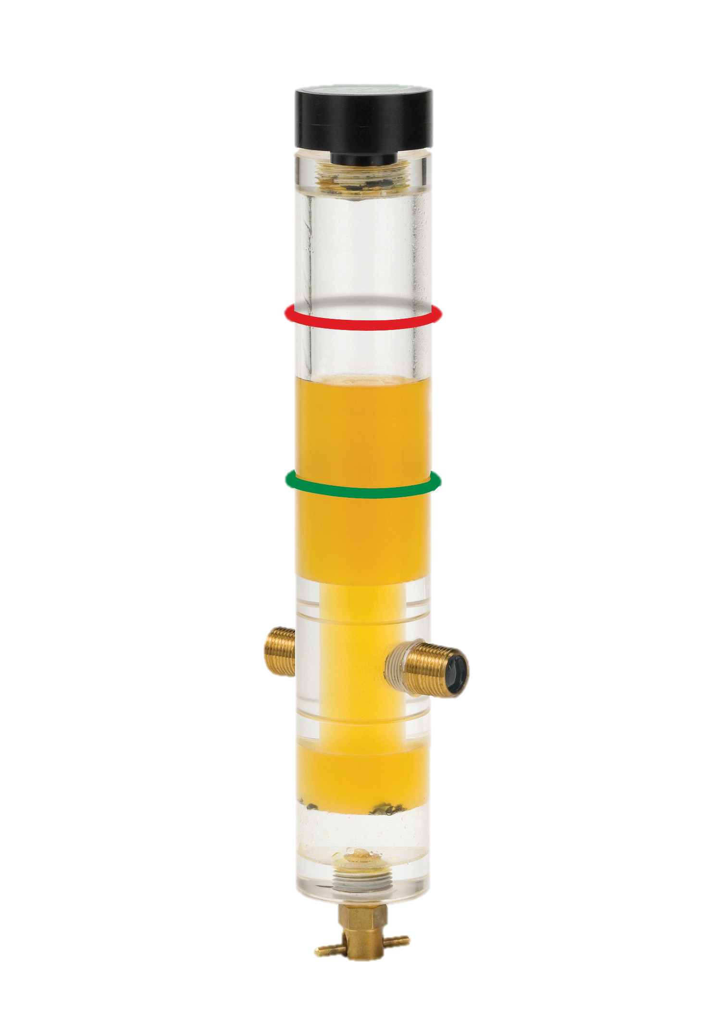
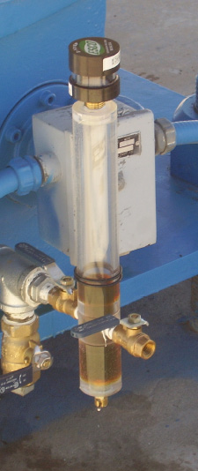
Dual Port Models – Sampling Abilities

Slide 18
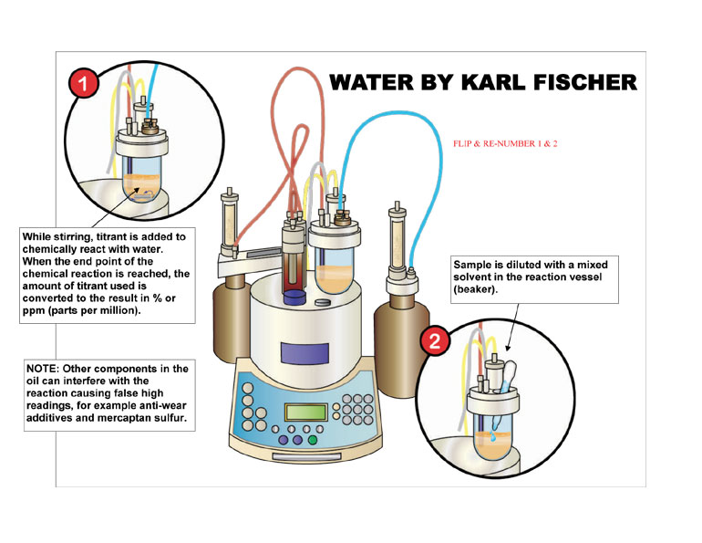
Measuring Water Content
ASTM D6304

Slide 19

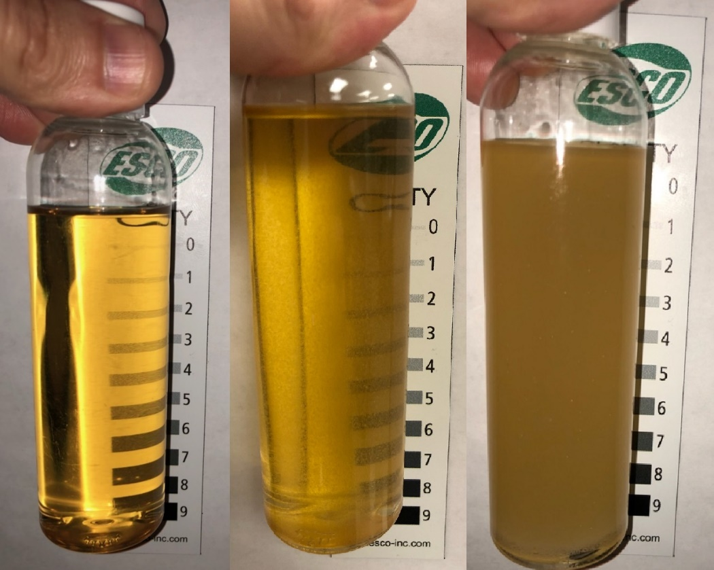
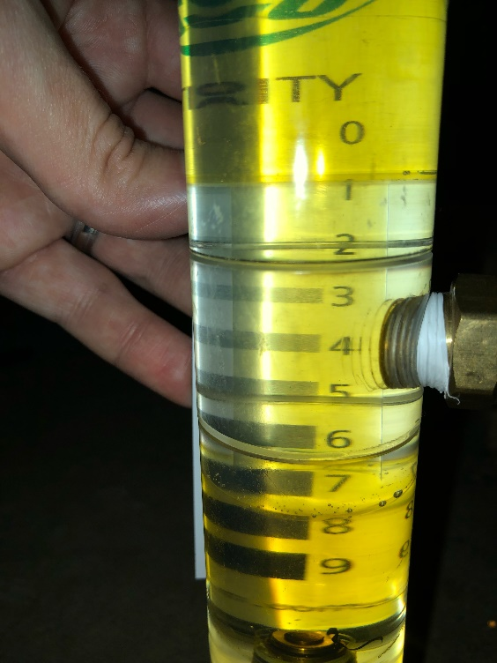
Water/Clarity Magnet

Slide 20
Oil Color
Monitor Changes in Oil Color – This can be an early indicator of problems.
Wrong Lubricant Added
Increased Water Content
Cross-Contamination
Base Oil Oxidation
High Operating Temperature
Increased Particle Contamination

Slide 21
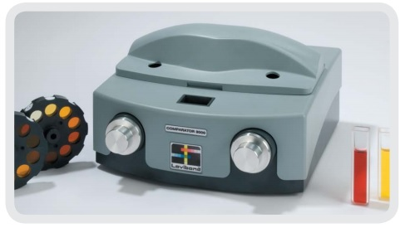
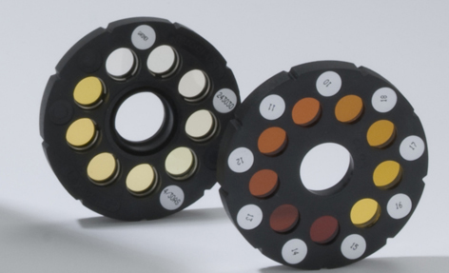
ASTM D1500 Color Scale

Slide 22
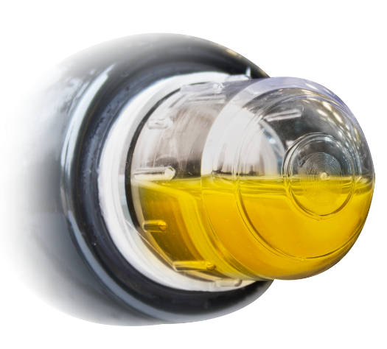
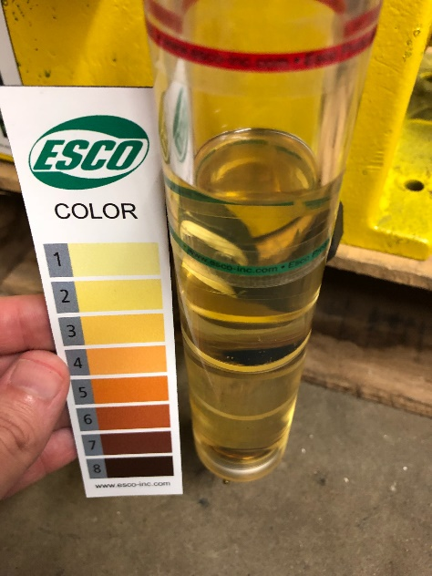




Color Monitoring Magnet

Slide 23

Excessive Operating Temperature
For every 10°C (18°F) increase in temperature, the oxidation rate of oil doubles, cutting the usable life of the lubricant in half.
Depletes Additives
Decreases Viscosity (Film Strength)
Increases Rate of Corrosion
Promotes Sludge & Varnish

Slide 24



Monitoring Operating Temperatures

Slide 25


Magnets in Use

Slide 26

Preventing Water Contamination

Slide 27


Equipment Vents

Slide 28


Desiccant Breathers

Slide 29


Finding the Source of Contamination…

Slide 30

Lubricant Storage & Dispensing

Slide 31




Color-Coded Containers

Slide 32




Easily Identifying Lubricants

Slide 33


Improving Current Practices
Small Improvements add up to big results

Slide 34


Improving Current Practices
Small Improvements add up to big results

Slide 35

Christopher Haught
Esco Products, Inc
chaught@esco-inc.com
www.EscoPro.com

